Slide 1
CP2404/CP5633 Database Modelling
Lecture 02

Slide 2
Lecture 2
Data Models & Relational Database Model
Reading: Coronel’s Chapter 2~3
Notes:
2

Slide 3
Learning Objectives
In this lecture, you will learn:
What is data modelling and why it is important?
Basic building blocks of data model
Business rule and its role in database design
The evolution of database models
Relational database model
Tables, attributes, relationships, keys, indexes
Integrity rules for RDB model
What are data dictionary and system catalog
Notes:
3

Slide 4
What is ‘Data Modelling*’?
Why is it important?
*‘Data Modelling’ is also called as ‘Database Modelling’

Slide 5


Warming Up Discussion
What are main roles of the blueprint in the course of building your house?
What components need to be included in the blueprint?

Slide 6
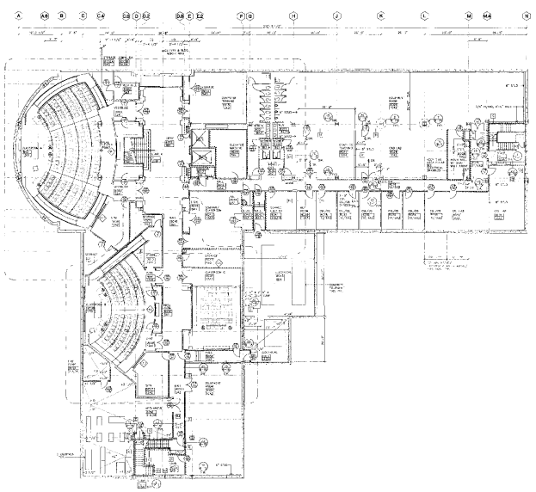
Data Modelling
Model
An abstraction of a more complex real-world object or event
Data model
Blueprint of the database
Graphical representation of complex data structure
Named as ‘Entity Relationship Diagram (ERD)’‏
6
Notes:
6

Slide 7
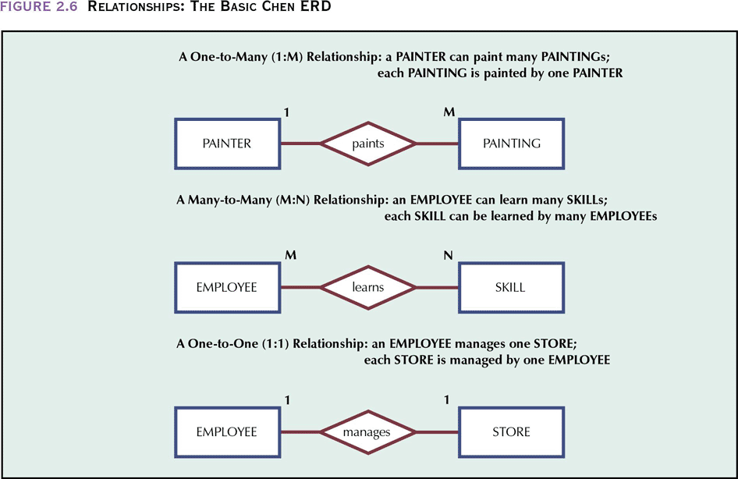
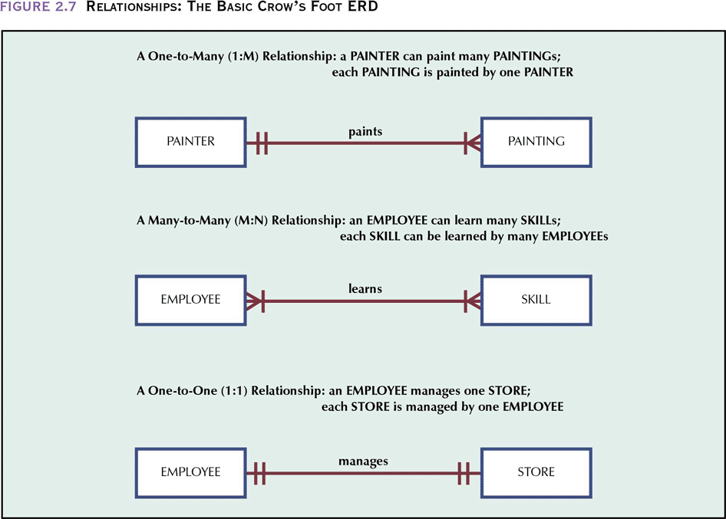
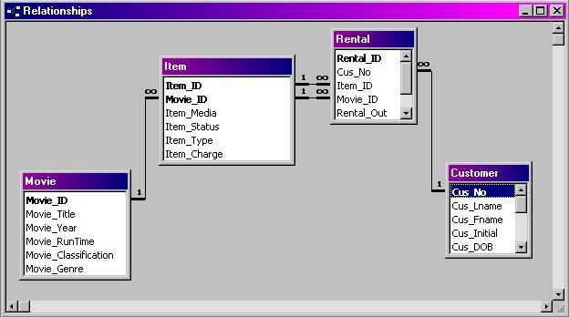
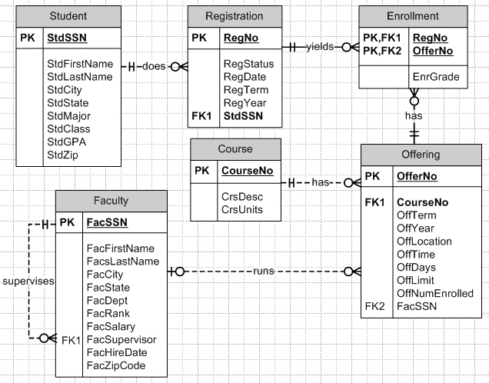
Data Model Examples

Slide 8
Why Data Modeling is Important?
Provide simple representation of complex data structure (abstraction)‏ → an overall view of the database
Data model facilitate communication among database designer, application programmer and the end users
“A picture is worth a thousand words”
8
Notes:
8

Slide 9
Basic building blocks of a ‘Database Model’

Slide 10
Basic Building Blocks of Database Models
Entity - anything about which data are to be collected and stored
Attribute - a characteristic of an entity
Relationship - describes an association among entities (1:1, 1:M or M:N)
Constraint - a restriction placed on the data (to ensure data integrity)
10
Notes:
10

Slide 11

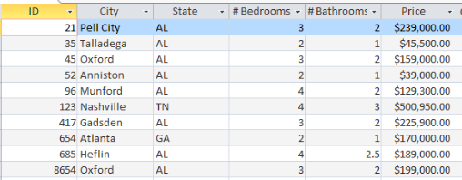
Entity
An entity is person, place, event, or thing for which we intend to collect data.
Example of an entity
Student
Faculty
Employee
House
Car
Book
DVD
Example:
Do you want to store data about rental properties (houses) managed by a real estate? Then the Real Estate Agency database must have an entity named ‘House’
11
Notes:
11

Slide 12
Can you recognise how entities are presented in the following data models?

Slide 13
Attributes
Each entity has certain characteristics known as attributes.
# of Bedrooms
Square Feet
Year Built
# of Bathrooms
# of Stories
Air-conditioned?
Price
Swimming Pool
13
Notes:
13

Slide 14
Can you recognise how attributes are presented in the following data models?

Slide 15
Do this now
What are some possible attributes for the entity Mobile Phone? (in a database for a mobile phone retailer)
What are some possible attributes for the entity Student? (in a database for a University)

Slide 16
Relationship
Relationship - describes an association among entities
One-to-many (1:M) relationship
Painter and painting
Many-to-many (M:N or M:M) relationship
Student and subject
One-to-one (1:1) relationship
Store manager(employee) and store
16
Notes:
16

Slide 17
Can you recognise how relationships are presented in the following data models?
Notes:
.

Slide 18
Do this now
What are the relationships (1:1, 1:M, or M:N) between the following two entities?
Author and Book ?
Person and Passport?
Time Zone and City?

Slide 19
Constraint
Constraint is a restriction (set of rules) placed on the data
Employee’s salary must have value that between 6,000 and 350,000
A student GPA must be between 0 and 4
Each class must have only one lecturer
A subject can prescribe maximum two text books.
19
Notes:
19

Slide 20
Can you recognise how constraints are presented in the following data models?

Slide 21
Business rule and its role in database design

Slide 22
So, how can we decide all of these?
Entity, Attributes, Relationships, Constraints etc.
Follow Business Rules !!
22
Notes:
22

Slide 23
Warming Up Discussion
Here is a report from a college help desk database.
If you were going to design a new database to store this data, what would you have to do firstly? Consider the following initial tasks.
List the stakeholders who should be interviewed.
List all the potential data elements on this report form.
Using the form given above, see what abbreviations or terms you don’t understand?
Make a list of questions you would ask someone if you were going to make a database to store this data.
Notes:
23

Slide 24
Business Rules
Brief, precise, and unambiguous descriptions of a policies, procedures, or principles within a specific organization
Describe characteristics of the data as viewed by the company
Not only limited to “business”, apply to any organization that stores and uses data to generate information
E.g., University, Government..,etc.
Help to define the basic building blocks (entities, attributes, relationships, and constraints) in data model
24
Notes:
24

Slide 25
Business Rules
Must be rendered in writing
Must be kept up to date
Must be easy to understand and widely disseminated
Examples of Business Rules
A customer may generate many invoices
An invoice is generated by only one customer
A training session cannot be scheduled for fewer than 10 employees or for more than 30 employees
25
Notes:
25

Slide 26
Do this now
What are the possible business rules for the database of JCU?
A student may enroll many subjects
A subject has only one subject coordinator
A subject will not be offered for fewer than 5 enrolled students
26
Notes:
26

Slide 27
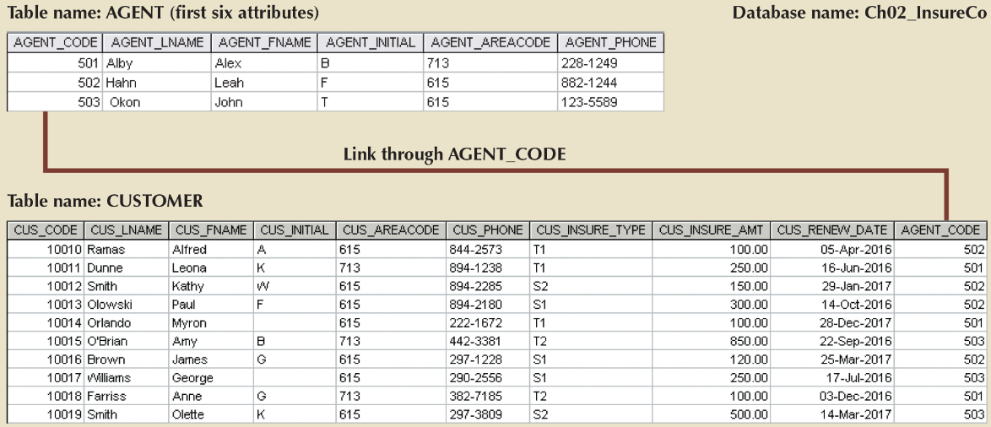
Do this now
What business rule(s) could be used to set the relationship between AGENT and CUSTOMER?
27
Notes:
27

Slide 28
Source of Business Rules
Company managers
Policy makers
Department managers
Written documentation
Procedures
Standards
Operations manuals
Direct interviews with end users
…
28
Notes:
28

Slide 29
Reasons for Identifying and Documenting Business Rules
Help standardize company’s view of data
Communications tool between users and designers
Allow designer to:
Understand the nature, role, scope of data, and business processes
Develop appropriate relationship participation rules and constraints
Create an accurate data model

Slide 30
Translating Business Rules into Database Model
Business Rules
Database Model
An author may write many books
A book must be published by only one publisher
...
30
Notes:
30

Slide 31
Translating Business Rules into Database Model
Generally, nouns translate into entities
Generally, verbs translate into relationships among entities
How many instances of B are related to one instance of A?
How many instances of A are related to one instance of B?
Relationships are bi-directional
“The relationship between CUSTOMER and INVOICE is 1:M” means that:
A customer may generate many invoices
An invoice is generated by only one customer
31
Notes:
31

Slide 32
Naming Conventions
Entity names are equired to:
be descriptive of the objects in the business environment
use terminology that is familiar to the users
Attribute name are required to:
be descriptive of the data represented by the attribute
Proper naming:
facilitates communication between parties
promotes self-documentation
32
Notes:
32

Slide 33
Evolution of Database Models
Relational Database Model

Slide 34
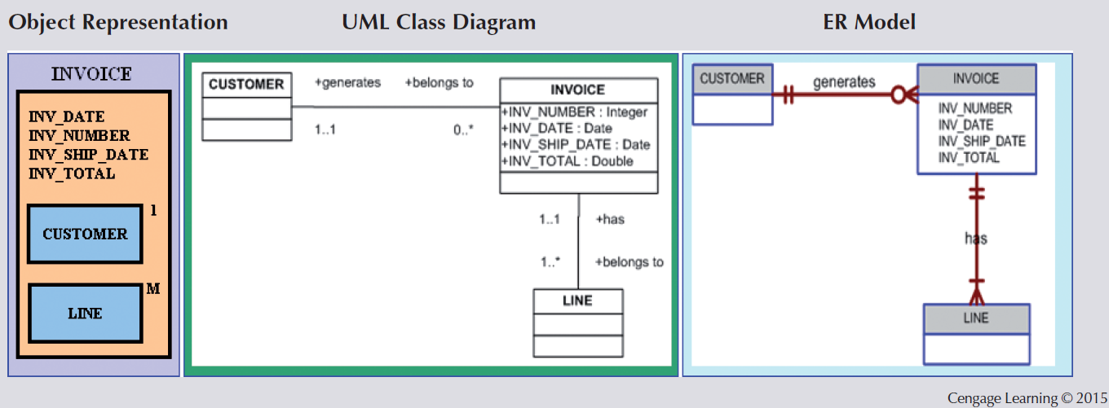
Evolution of Major Database Models
Mid-1970s to present
Relational
Mid-1980s to present
Object-oriented
Extended Relational
Present to future
XML, NoSQL
1960s~ 1970s
File system
1970s
Hierarchical
network
34
Notes:
34

Slide 35
Relational Database (RDB) Model
Developed by E.F. Codd (IBM) in 1970
Considered ingenious but impractical in 1970
Require intensive computation power to implement the relational model
Conceptually simple
A collection of tables for data storage
Based on a relation
Each table (called ‘relation’) represents an entity
Comprised of rows (tuples) and columns (attributes)
35
Notes:
35

Slide 36
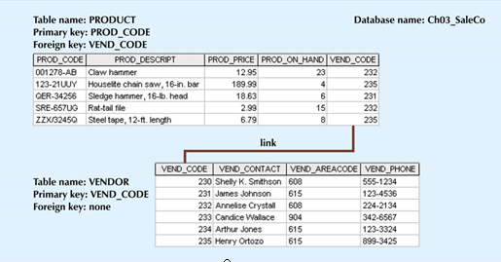
Relational Database Model
Tables are linked by sharing common entity characteristics (common column)‏
36
Notes:
36

Slide 37
Relational Database Model
Advantages
Structural independence (not navigational)‏
Improved conceptual simplicity
Easier database design, implementation, management
Ad hoc query capability with SQL
Powerful database management system
Disadvantages
Substantial hardware and system software overhead
Poor design and implementation is made easily
(Badly-designed model) May promote “islands of information” problems
37
Notes:
37

Slide 38
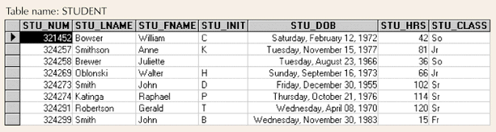
Relational Table Characteristics
Two-dimensional structure with rows and columns
Rows (tuples) represent single entity
Columns represent attributes
Row/column intersection represents single value
Tables must have an attribute (or attributes) to uniquely identify each row → key
Structural independent
How data are physically stored is of no concern to the user/designer
38
Notes:
38

Slide 39
Relational Table Characteristics
Values of the same column have same data format
Numeric
Character/Text
Date
Logical
Each column has a possible range of values called attribute domain
Order of the rows and columns is not important to the DBMS
39
Notes:
39

Slide 40
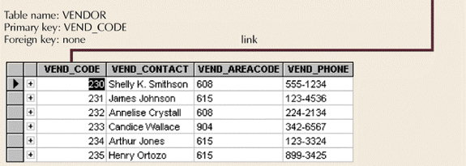
Relational Schema
Textual representation of the database tables
VENDOR(VEND_CODE, VEND_CONTACT, VEND_AREACODE, VEND_PHONE)‏
40
Notes:
40

Slide 41
Key Benefits of RDB Model
Relational database model enables logical representation (view) of the data and its relationships
Logical simplicity yields simple and effective database design methodologies

Slide 42
More about Keys
One or more attributes that determine other attributes
Used to:
ensure that each row in a table is uniquely identifiable
establish relationships among tables and to ensure the integrity of the data
The key’s role is based on a concept known as determination, which is used in the definition of functional dependence.
A → B (A determines B : B is functionally dependent on A)‏
A is eligible to be a primary key of one table means:
Knowing the value of an attribute A makes it possible to determine the value of any other attribute in the table
42
Notes:
42

Slide 43
Types of Keys
Superkey
Attribute or combination of attributes that uniquely identifies any given row (not necessary to be minimal)
Candidate key (eligible as a primary key)
Minimal superkey
Primary key (PK)
One of candidate keys selected (can’t contain null entries)
Composite key: key that is composed of more than one attribute
Key attribute: attribute that is a part of a key
Secondary key
Used only for data retrieval (may NOT be unique)‏
Foreign key
Values must match primary key in another table
43
Notes:
43

Slide 44
Null Values
No data entry
Can represent
an unknown attribute value
a known, but missing, attribute value
a “not applicable” condition
Can create problems when functions such as COUNT, AVERAGE, and SUM are used
Can create logical problems when relational tables are linked
Not permitted in primary key
Should be avoided also in other attributes
44
Notes:
44

Slide 45
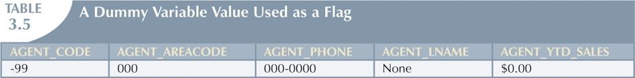
Ways to Handle Nulls
Flags: Special codes used to indicate the absence of some value
NOT NULL constraint - Placed on a column to ensure that every row in the table has a value for that column
UNIQUE constraint - Restriction placed on a column to ensure that no duplicate values exist for that column
45
Notes:
45
It would be best if we can avoid using null values even in other attributes.
There are some ways used by database designers to avoid nulls.

Slide 46
Integrity Rules for Relational Database Model

Slide 47
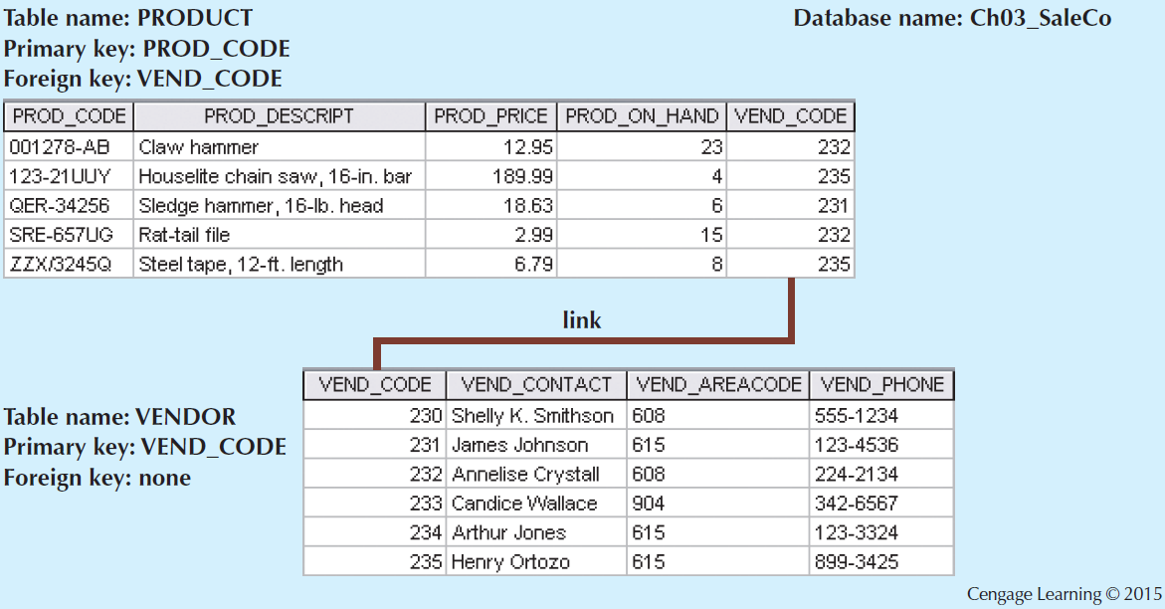
Integrity Rules for Relational DB
Entity Integrity Rule
Ensures all entity instances are unique
Each entity instances has unique and non null primary key
Referential Integrity Rule
Foreign key must match primary key values or have null value
Makes it impossible to delete row whose primary key has mandatory matching foreign key values in the related table
47
Notes:
47
Relational database integrity rules are very important to good database design.
RDBMSs enforce integrity rules automatically, but it is important to understand the rules as a database designer and to make sure your design conforms to two integrity rules:
Entity Integrity rule and
Referential Integrity rule.
These rules are summarised here:
Entity Integrity:
Requirement: All primary key entities are uniwue, and no part of a primary key may be null.
Purpose: Each row will have a unique identity. By keeping this rule, foreign key values can properly reference primay key values.
Example: In Product table, no product can have a duplicate Product_Code, nor can it be null. (In shorts, all products are uniquely identified by their product code)
Referential Integrity:
Requirement: A foreign key may have either a null entry, as long as it is not a part of its table’s primary key, or an entry that matches the primary key value in a table to which it is related. (In other words, every non-null FK value must reference an existing PK value)
Purpose: It is possible for an attribute not to have a corresponding value (which means null), but it will be impossible to have an invalid entry; This enforcement of the referential integrity rule makes it imposible to delete a row in one table whose primary key has mandatory matching foreign key values in another table.
Example: A product might not have information about its vendor (vendor code), but it will be impossible to have an invalid vendor code related.

Slide 48
Data Redundancy Revisit
Data redundancy leads to data anomalies
Such anomalies can destroy the effectiveness of the database
Foreign keys
Controlled data redundancies by using common attributes shared by tables
Crucial to exercising data redundancy control
Sometimes, data redundancy is necessary
To preserve the historical accuracy of the data
To make the database serve crucial information purposes
48
Notes:
48

Slide 49
Index, Data Dictionary, System Catalog

Slide 50
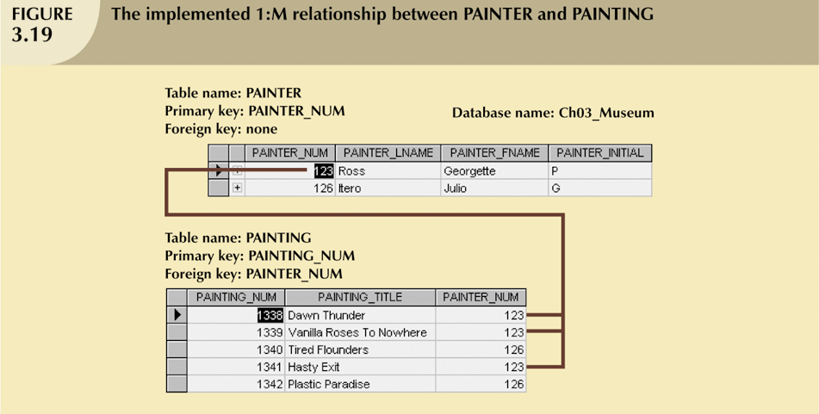
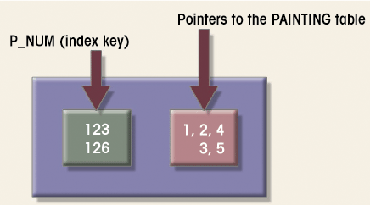
Indexes
Orderly arrangement used to logically access rows in a table
Index key
Index’s reference point
Points to data location identified by the key
Unique index
Index in which the index key can have only one pointer value (row) associated with it
Each index is associated with only one table
50
Notes:
50
In the relational database environment, indexes are generally used to speed up and facilitate data retrieval.
An index is an orderly arrangement used to logically access rows in a table.
From a conceptual point of view, an index is composed of an index key and a set of pointers. The index key is, in effect, the index’s reference point. Each key points to the (logical) location of the data identified by the key. A table can have many indexes, but each index is associated with only one table.
Example:
The figure presents the example of index created for the PAINTING table. Suppose you want to look up all of the paintings created by a given painter. Without an index, you must read each row in the PAINTING table and see if the PAINTER_NUM matches the requested painter. This job would not be quick or easy in particular if the table contains a huge number of data entries (records). However, if you index the PAINTER table and use the index key PAINTER_NUM, you can easily find the matching pointers via the index.
Please note that this index is associated with the painting table. If the Painter_Num is used as FK in other tables, we have another separate index associated with the another table.

Slide 51
Data Dictionary and System Catalog
Data dictionary
Description of all tables in the database created by the user and designer – Metadata
Attribute details like type, formats etc.
System catalog
Detailed data dictionary (description of all objects in the database)
System-created database
Stores database characteristics and contents
Automatically produces database documentation
51
Notes:
51

Slide 52
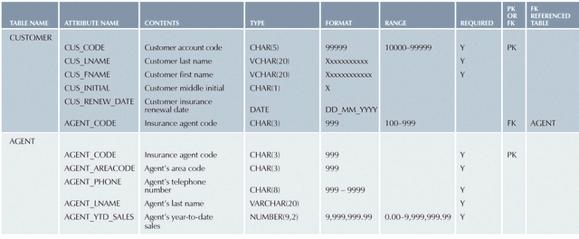
A Sample Data Dictionary
Homonyms and synonyms must be avoided to lessen confusion
Homonyms: the use of the same attribute name to label different attributes
Synonyms: the use of a different name to describe the same attribute
52
Notes:
52

Slide 53
Summary 1
A data model is an abstraction of a complex real-world data environment
DB designers use data models to communicate with programmers and end-users
The basic data modelling components are entities, attributes, relationships, and constraints
Business rules are used to identify and define the basic modelling components within a specific real-world environment
Notes:
53

Slide 54
Summary 2
The Relational DB model is the current DB implementation standard
Relational tables composed of rows and columns are the basic building blocks of a RDB
Keys are central to use of relational tables.
Each table row must have a primary key (PK) which uniquely identifies all remaining attributes in a given row record
The PK of one table can appear as the foreign key (FK) in another table to which it is linked
Notes:
54

